Slide 1
Gear Systems
Gear Trains
Chain-Sprocket systems
Worm and Worm-gear Systems
Friction-Gear (toothless)Systems
Belt and Pulley Systems

Slide 2
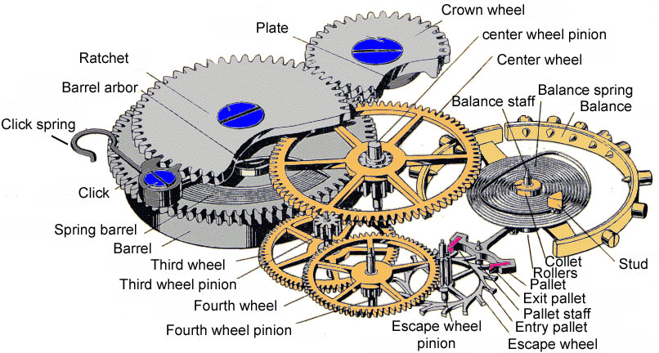
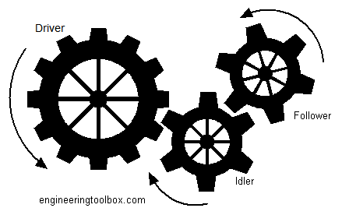
Gear Trains: two or more toothed gears that mesh with each other;
includes gear boxes that we’ve already studied.
Example 1: Try to identify where these would be found.
______________________
Example 2: Calculate the velocity ratio for the following.
Note that the “driver” gear is the input.

Slide 3
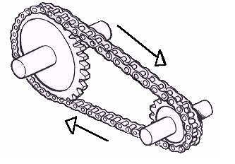
2. Chain-Sprocket Systems: toothed gears connected by a chain
Example 1: What advantage does this system have over a gear train?

Slide 4
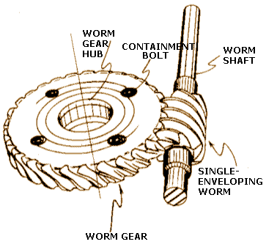
3. Worm& Worm-gear System: The input gear is a screw-like “worm”, and the output is one or more toothed gears known as worm-gears. It’s not reversible.
Example 1: Which part do you think turns very easily?
Example 2: If the velocity ratio is low, what can be said about the mechanical ratio?

Slide 5
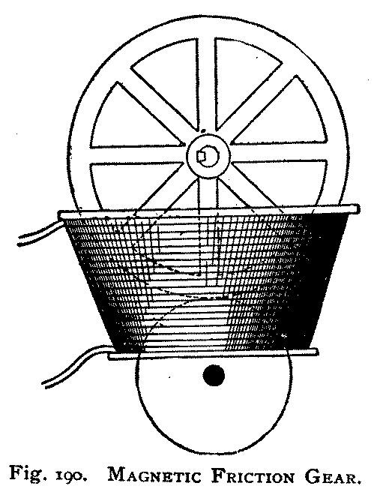
4. Friction-Gear (toothless)Systems: like a gear train without the teeth
Example 1: The two wheels(‘gears”) are made out of iron.
What makes them stick together?

Slide 6
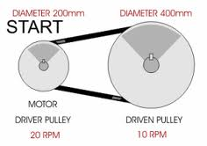
5. Belt and Pulley Systems: has pulleys that include grooves that allow the belt to fit.
Example 1: What makes this system different from a chain-sprocket system?
Example 2: What is the mechanical ratio of this system? Velocity ratio?

Slide 7
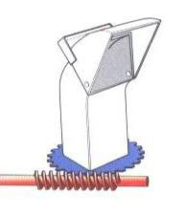
More Examples
a) This is part of a snow blower.
What type of gear system is this?
b) Name the input. (what type of gear is this?)
c) If you try to turn the chute manually,
why is that a bad idea?

Slide 8
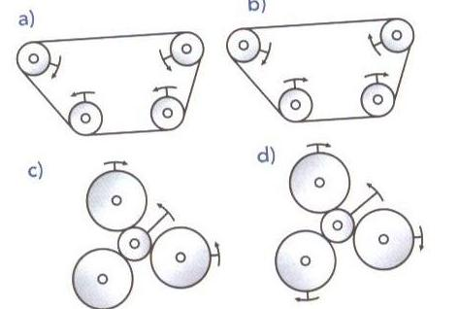
2. Which systems show the real motion?

Slide 9
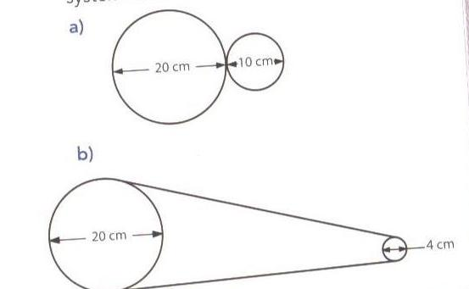
3. a) Calculate the velocity(speed) ratio if the larger one is the input.
b) What kind of systems are these, assuming no teeth on the gears?

Slide 10
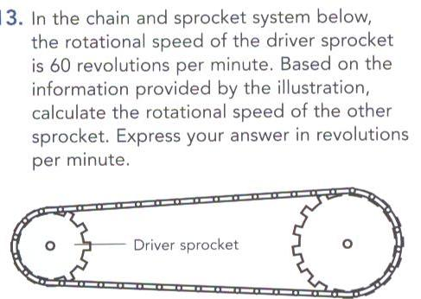
4.
5.

